Slide 1


Govt Polytechnic Sorab Department of Computer Science and Engineering PROJECT PHASE SEMINAR ON “Tweep Fake-Twitter deep Fake”
Presentation by:
1.Rakesh S
2.Gurukian J S
3.Madan R
4.Dhanajay K N

Slide 2
1.Data collection Import Libraries and Load Data Set
import pandas as pd
import numpy as np
import matplotlib.pyplot as plt
import seaborn as sns
from sklearn.metrics import confusion_matrix
from sklearn.model_selection import train_test_split
from sklearn.linear_model import LinearRegression
from sklearn.metrics import mean_squared_error,r2_score
from sklearn.feature_extraction.text import TfidfVectorizer
from sklearn.preprocessing import LabelEncoder
from scipy.sparse import hstack
from sklearn.linear_model import LogisticRegression
from sklearn.metrics import accuracy_score, classification_report
df=pd.read_csv('D:/2. College files/Diploma/5th Sem/PROJECT/p1/train.csv')

Slide 3
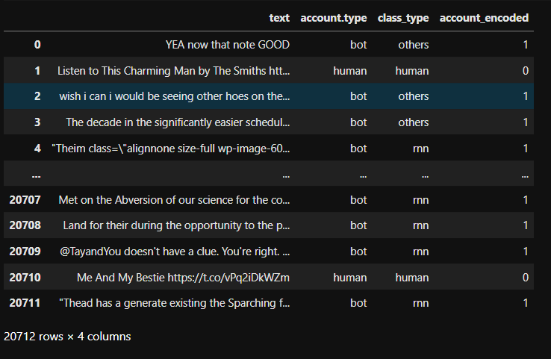
#Encode categorical to numeric for numeric ops df['account_encoded'] = df['account.type'].map({'human': 0, 'bot': 1}) df

Slide 4
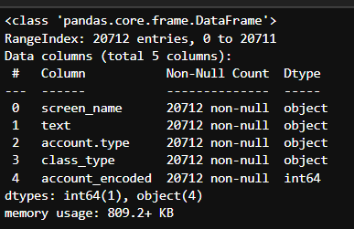
2.Data Analysis df.info()

Slide 5
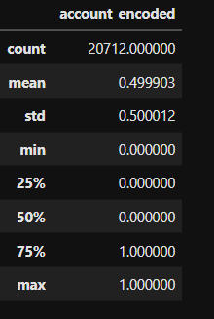
df.describe()

Slide 6
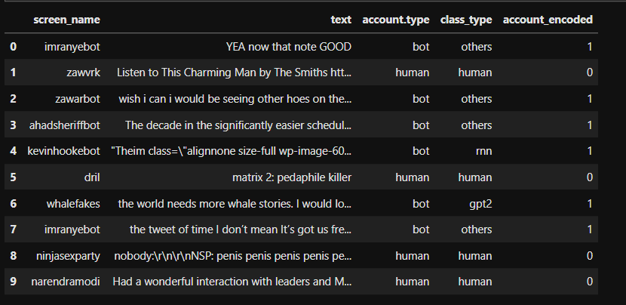
df.head(10)
.

Slide 7
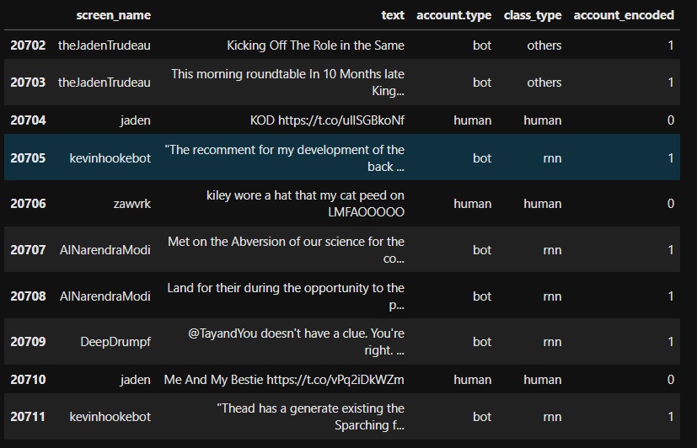
df.tail(10)

Slide 8

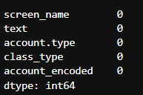
print("\nShape of DataFrame:", df.shape)
df.isnull().sum()

Slide 9
.df.columns
.

Slide 10






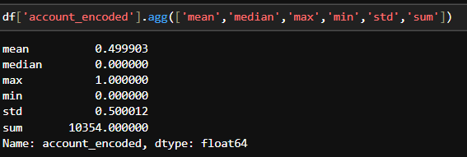

Aggregaion functions

Slide 11
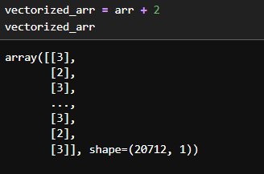
Vectorization

Slide 12
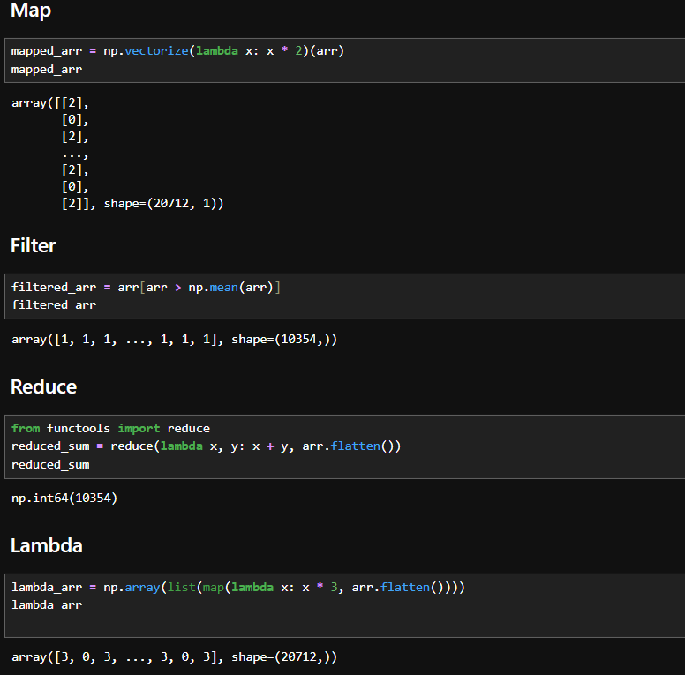
Map,filter,Reduce,Lambda

Slide 13
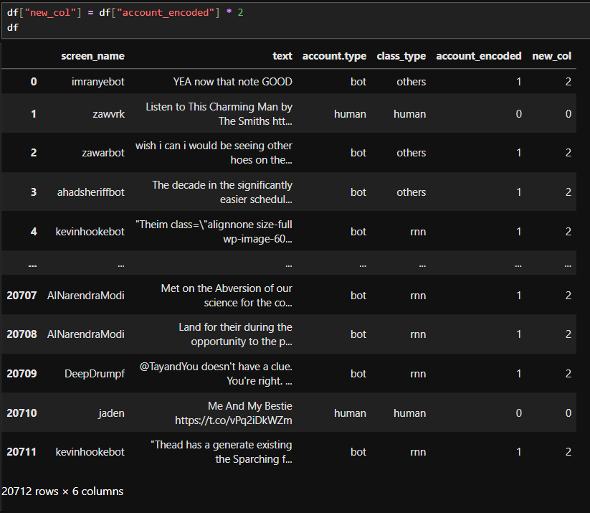
Column add and drop¶

Slide 14
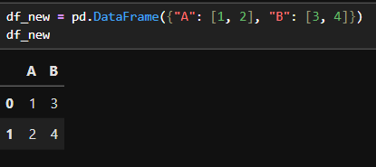
===== PANDAS OPERATIONS ===== 3.Data Preprocesing and cleaning¶
. Create DataFrame

Slide 15
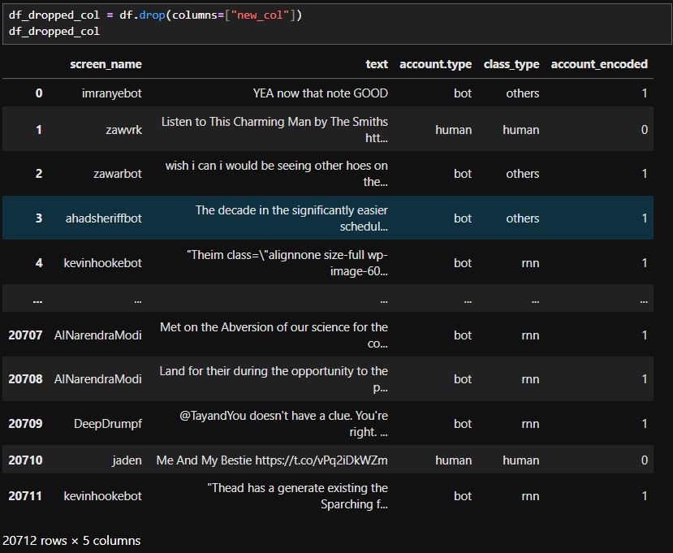
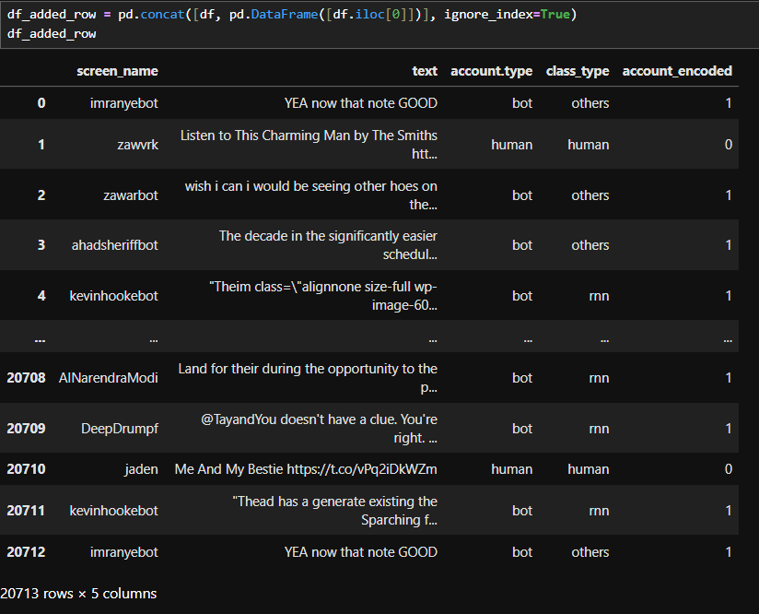
Drop column Row add and drop

Slide 16
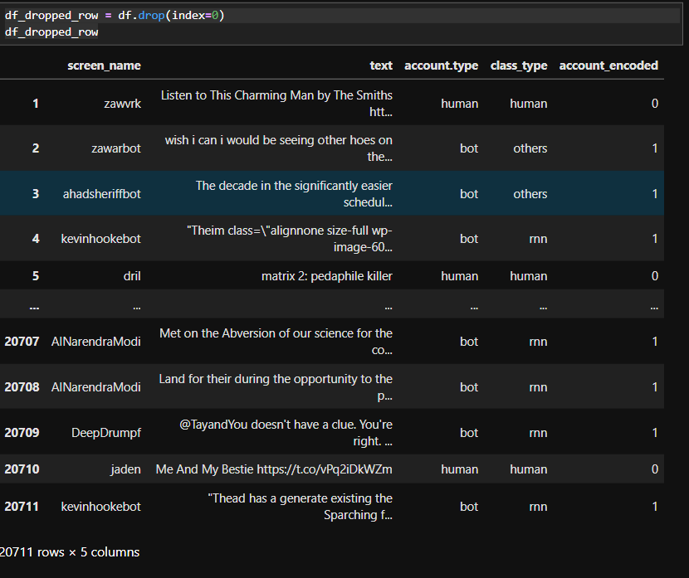
df_dropped_row = df.drop(index=0) df_dropped_row

Slide 17
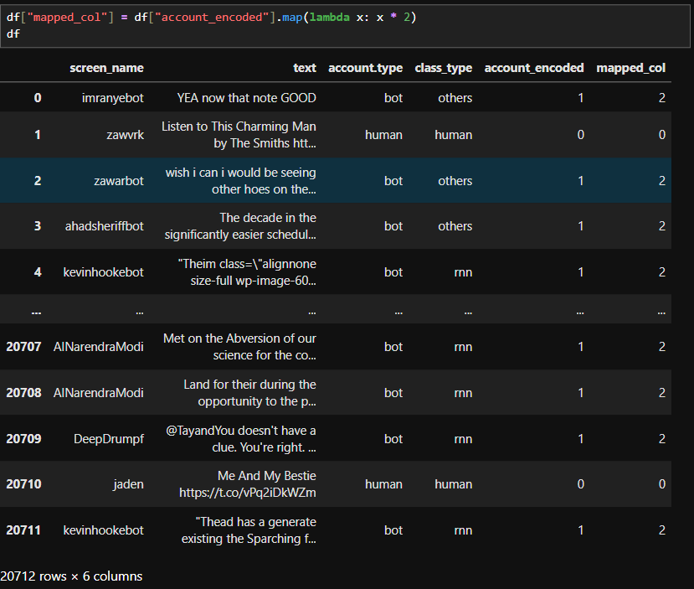
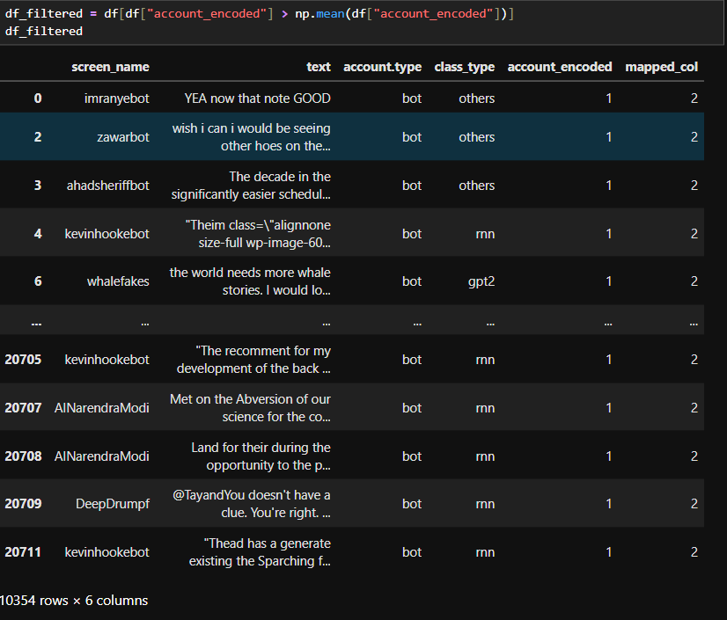
Map Filter

Slide 18
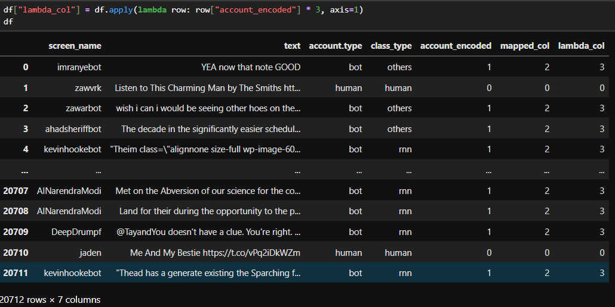
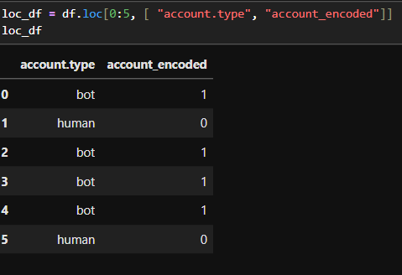
Lambda Loc

Slide 19
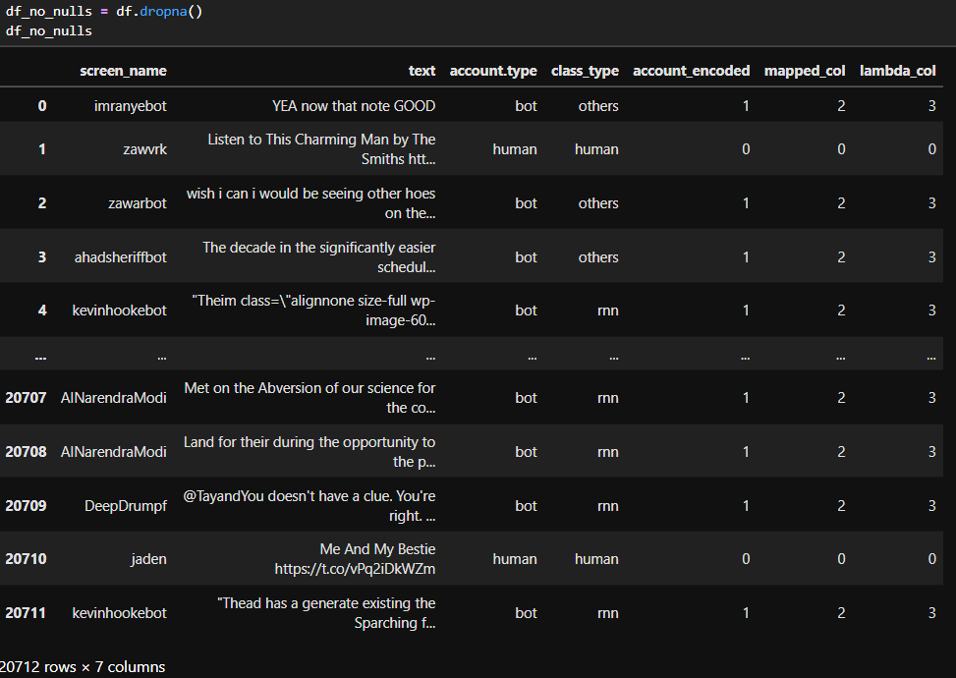
Delete null rows

Slide 20
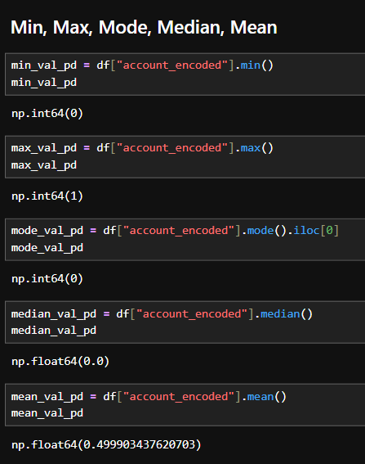
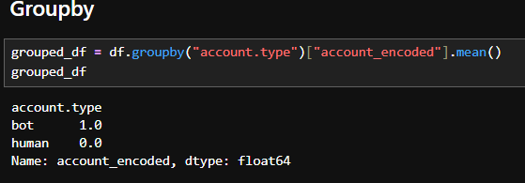
. Groupby

Slide 21
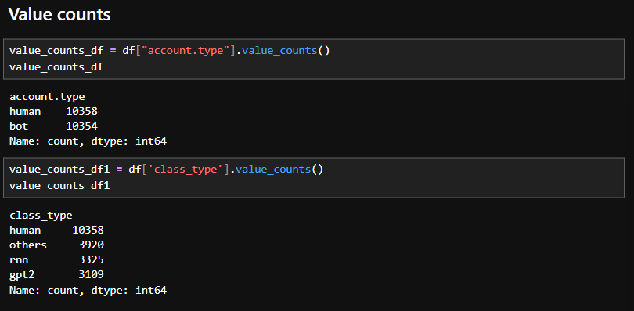
.Value Counts

Slide 22
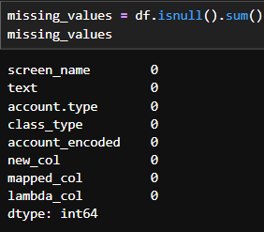
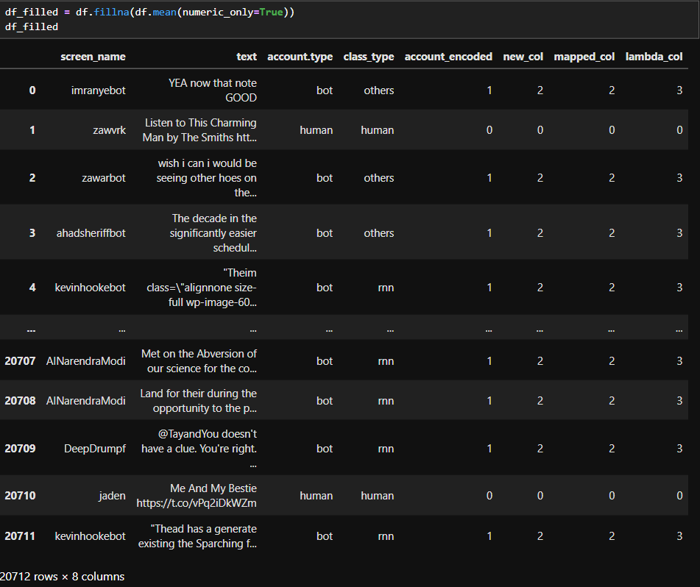
===== MISSING VALUES / OUTLIERS ===== Missing values Fill missing values with mean

Slide 23
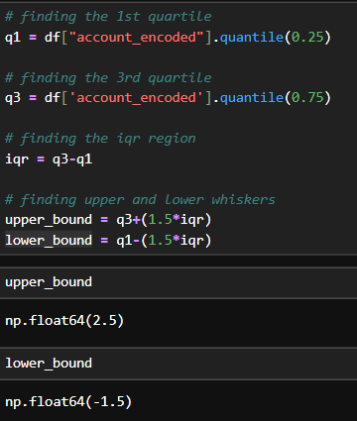
Handling outliers using IQR

Slide 24
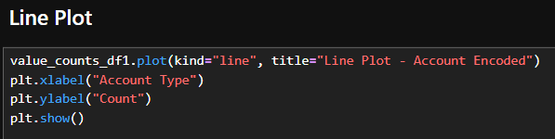
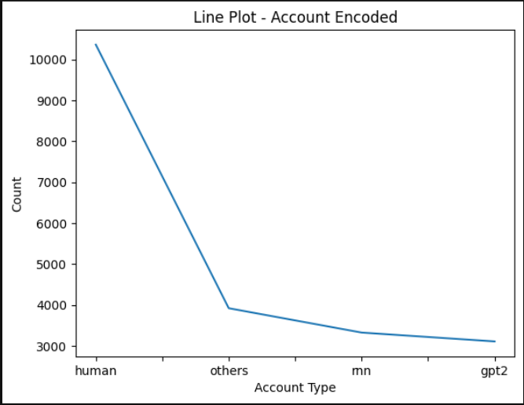
PANDAS PLOTS . UNIVARIATE ANALYSIS

Slide 25
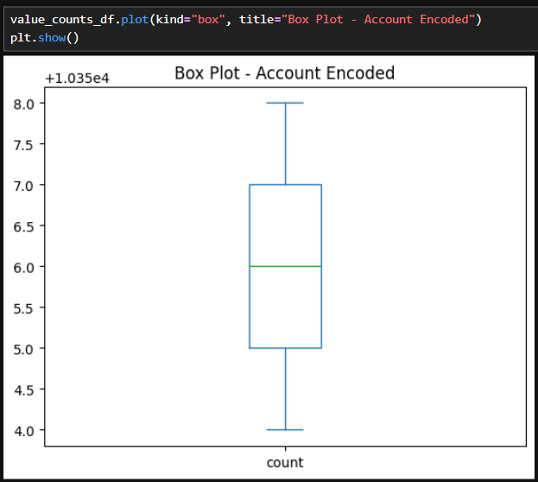
Box Plot

Slide 26
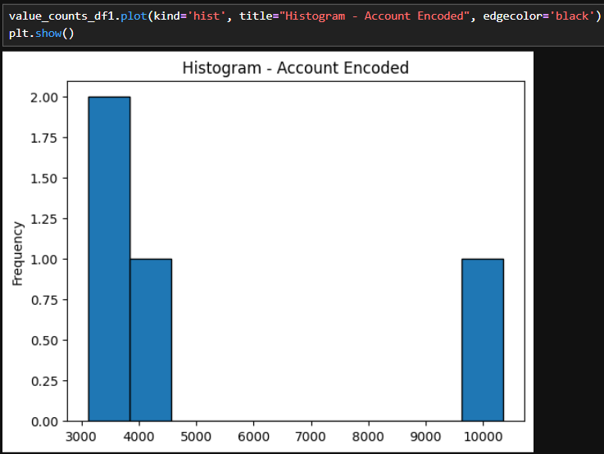
Data Visuvatization Histogram

Slide 27
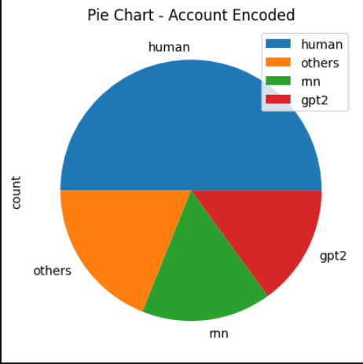

Pie Chart

Slide 28
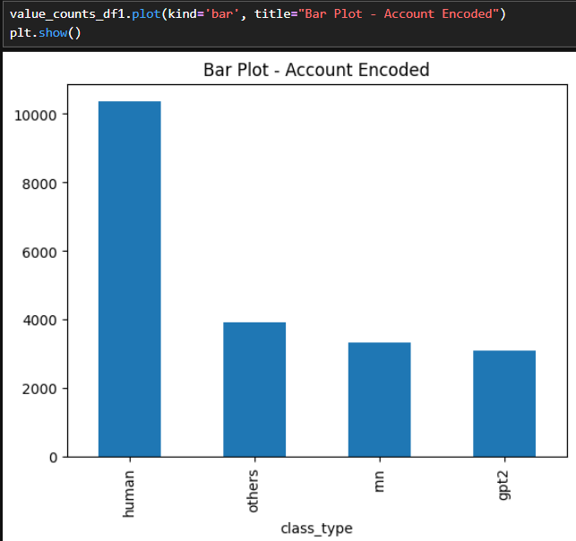
Bar Chart

Slide 29
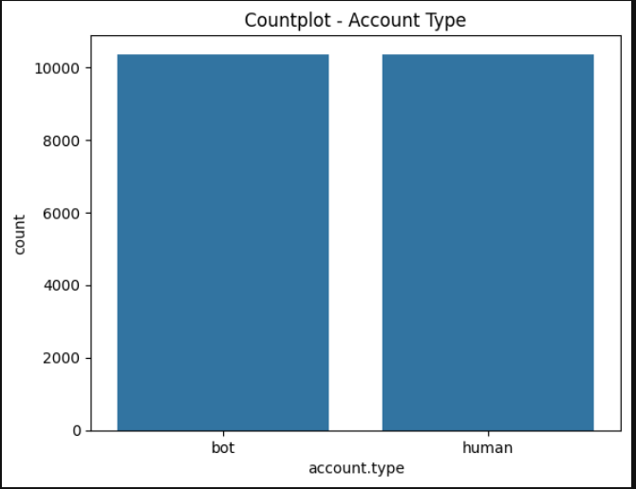

Seaborn Count Plot

Slide 30
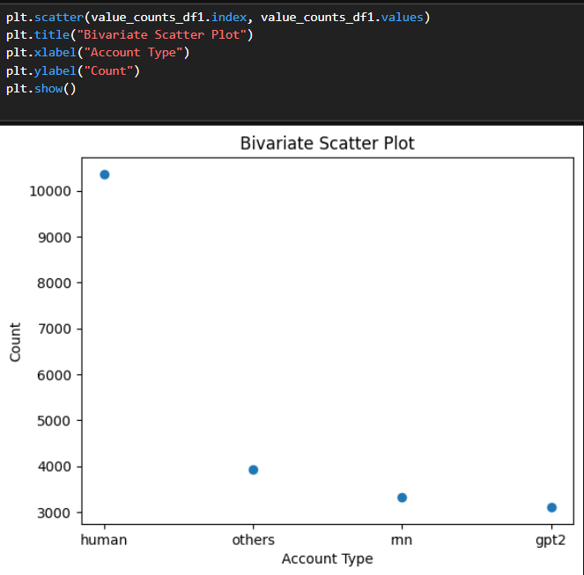
BIVARIATE ANALYSIS . Scatter Plot

Slide 31
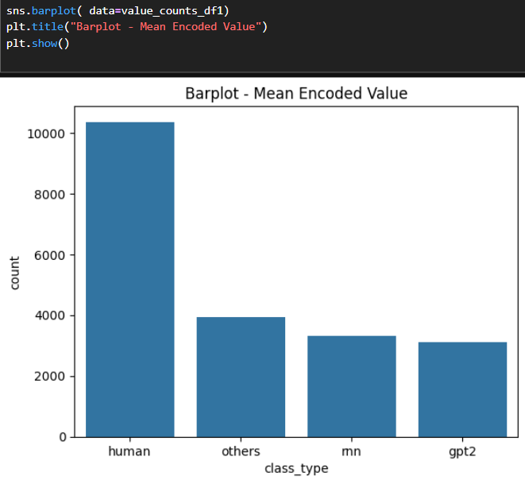
Seaborn Bar Plot

Slide 32
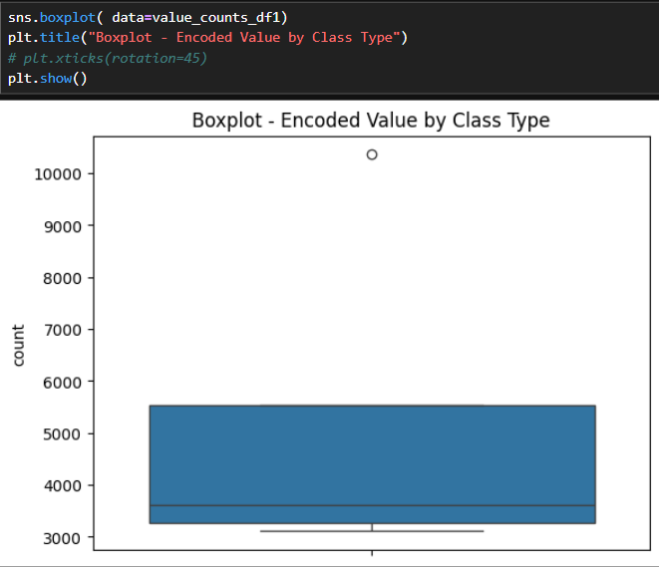
Box Plot

Slide 33
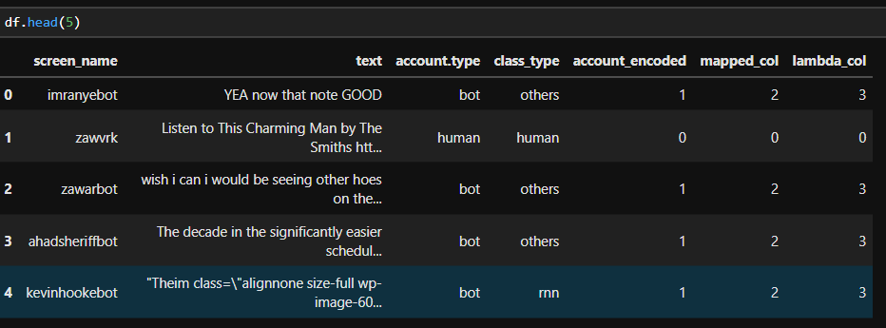
5.Data Training and Testing

Slide 34
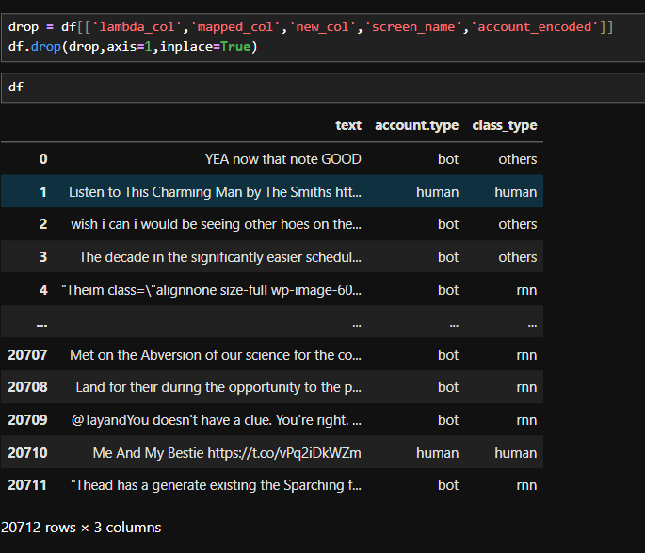
.

Slide 35
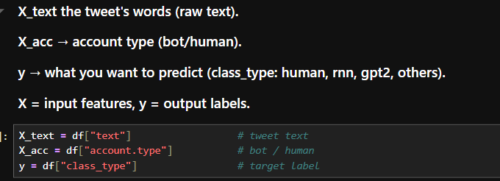
Independent and dependent variables

Slide 36
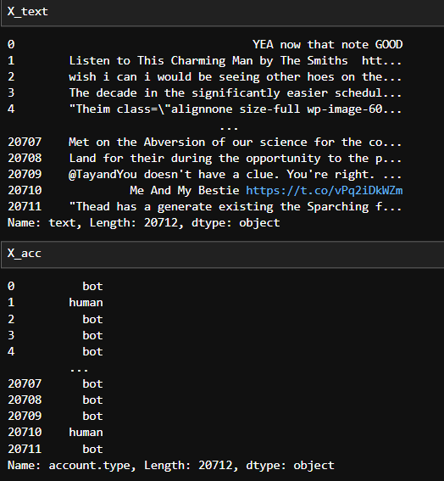
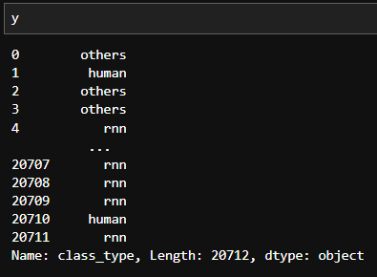
.

Slide 37
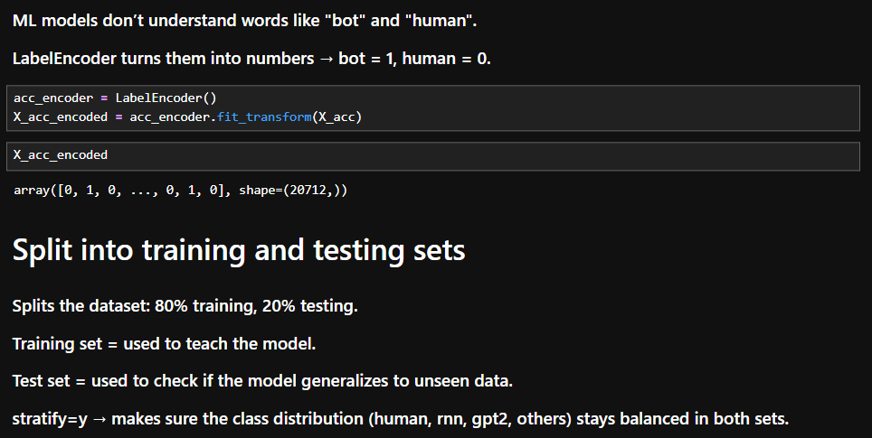
Encode account.type into numeric (bot=1, human=0)

Slide 38
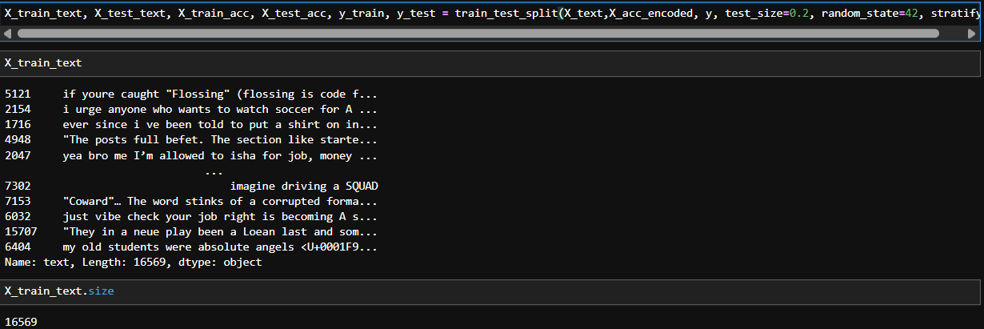
.

Slide 39
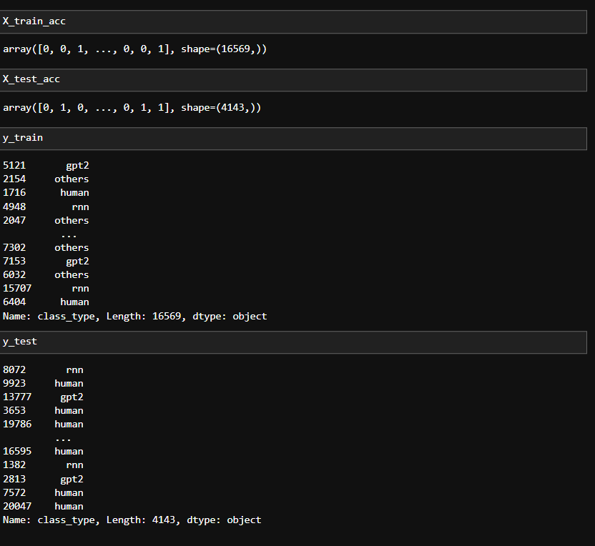
.

Slide 40
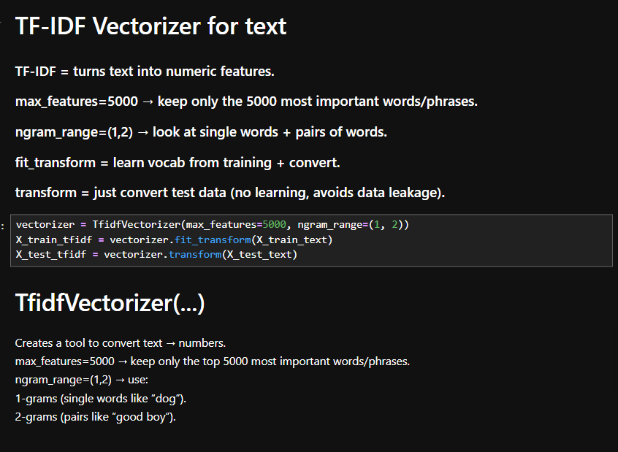
TF-IDF Vectorizer for text

Slide 41
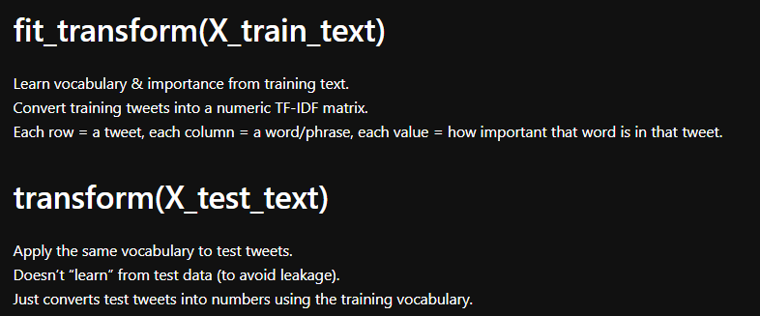
.

Slide 42
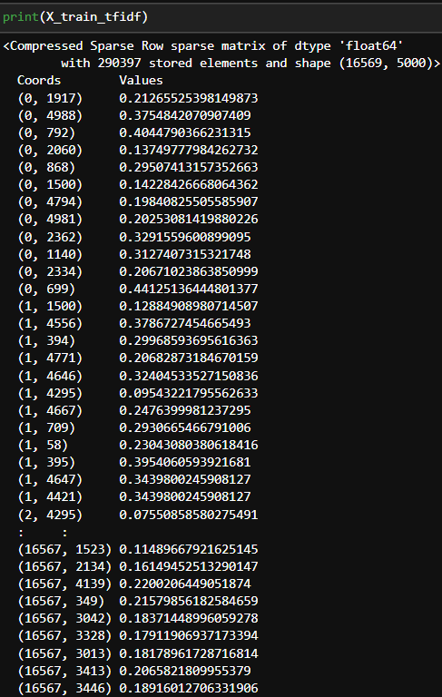
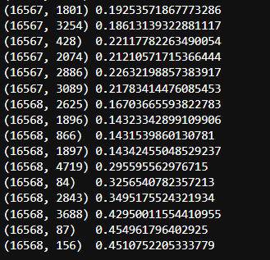
.

Slide 43
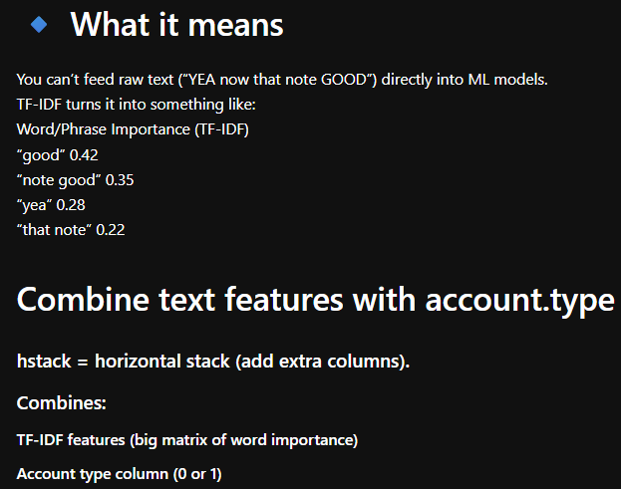
.

Slide 44
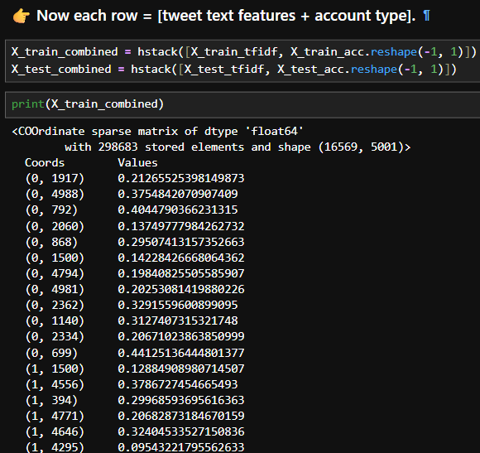
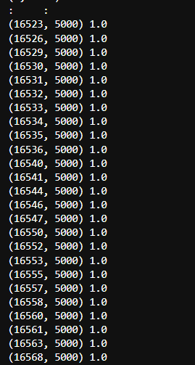
.

Slide 45


.

Slide 46

.

Slide 47

.

Slide 48

.

Slide 49

.

Slide 50

.

Slide 51

/

Slide 52

.

Slide 53

,

Slide 54


.

Slide 55
.
THANK YOU

